Slide 1

Housing in the State of Washington
Group One: Valerie, Yang
Notes:
our dataset is about a group of house houses completed in 1995 and were revalued in 2014 for resales

Slide 2






Introduction
Dataset from 2014 to 2015.
We are using housing price from a sample of 21613 and analyzing how external factors influence the housing price.
Nine sources .

Slide 3
CONTENTS
01
Research Question & Hypothesis
02
Literature Review
03
Methodology & Statistical Results
04
Conclusions & Suggestions
Notes:
We will be going over our research questions first then proceed to go over what we found our from our literature review. After our literature review we will step into our methodology and statistical summary of our data. We will then conclude with our findings using the relevant data to give our recommendations.

Slide 4

PART 01
Research Question & Hypothesis

Slide 5

Does "GRADE" have the greatest impact on housing prices among the number of bathroom, floors, and size of living room?
Notes:
For this research question. Grade will be our main independent variable and housing price will be the only one dependent variables. Bathrooms, floors, and size of living room will be the control. We will define all those variables sepecifically in the later slide.

Slide 6
DATA CLEANING
No missing values
No string values
df['price_new'] = df['price']/1000
Notes:
Before we start collecting all the graphs and models. We did some data cleaning.
In our data cleaning result, it shows that we do not have any missing (null) values in our dataset. and all data of the variables are integers so we don't need to deal with the capitalization.
We also noticed that if we keep the original price index, there will be some error on the regression model's value.
Therefore, we will use the formula here shows in the slide to resolve this problem.

Slide 7
Hypothesis
01
Price & Grade
H: House prices increase with the increase in grade.
Price & Sqft_Living
02
H: House prices increase with the increase of living room size.
03
Price & Floors
H: House prices increase with the increase in the number of floors.
Price & Bathrooms
04
H: House prices increase with the increase in the number of bathrooms
Notes:
For our research question, we will mainly focus at analyzing the independent variable of Grade.
At the same time, we will also analyze how does sqft-living, floors, and bathrooms impact the housing price.
So, here are our hypthoesis for each of the vaiable:
Firstly, we assume that House prices increase with the increase in grade.
Secondly, we assume that House prices increase with the increase of living room size.
Thirdly, we assume that House prices increase with the increase in the number of floors.
Moreover, we assume that House prices increase with the increase in the number of bathrooms.

Slide 8
PART 02
Literature Review

Slide 9
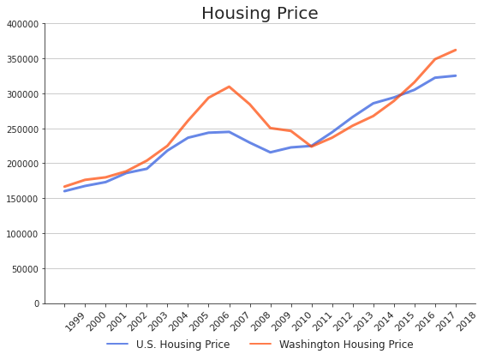
Housing Price
From 2002 to 2007, home price increased by over $121,000, a gain of 64%.
From 2007 to 2009, the price went down by 24%.
From 2009 to 2019, price increased by 58.9%.

Slide 10
Personal Income
Washington per Capital Personal Income
2017
$60,628
2016
$58,872
2015
$57,295
2014
$54,922
2013
$52,257

Slide 11
Determinants of Housing Price
The value of the house itself:
Number of bedrooms
Number of bathrooms
Housing facility
Size of living room, lot and basement. etc.
Neighbourhood amenities:
Grade
Location
The quality of local public goods
Crime rates
Notes:
Category:
We didn’t find the accurate definition of neighbourhood in the housing market, since it is a very broad term. It could mean the neighbour, the residents and the characteristics. Meanwhile, it could be the living condition such as grade location, the quality of local public goods and crime rates.

Slide 12
Define Variable
The Number of Great School
Grade
Housing Price
The Number of Floor
Floors
Price
Variables
The Number of Bathrooms
Bathromms
Sqft_Living
Size of Living Room
Notes:
Based on the data sets, our research are limited by the number of variables. We dont have some variables like crime rates, transpotation or conveniences index. So we will mainly focus on category one.
Those are all qualified data variables.

Slide 13
PART 03
Methodology & Statistical Results

Slide 14
Rules and Assumptions
1. Residential vs. Commercial
3. Housing Price
Before property tax
4. Grade
2. Unit of Area: ft²
A: 9 - 10
B: 7 - 8
C: 4 - 6
D: 1 - 3

Slide 15
Regression Model
Price = β0 + β1grade + β2sqft_living + β3floors + β4bathrooms + ϵ
#price ~ grade + sqft_living + floors + bathrooms
There is statistical significance between:
Price and grade
Price and sqft_living
Price and floors
Price and bathrooms
Notes:
Here is the function that we will use for our regression model.

Slide 16
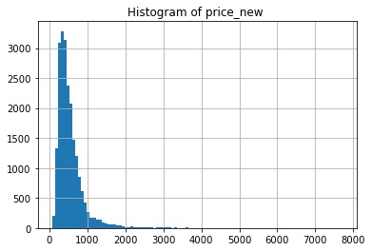
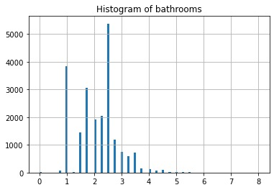
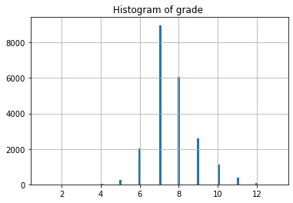
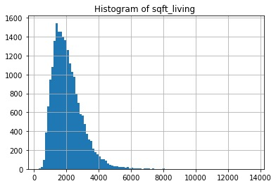
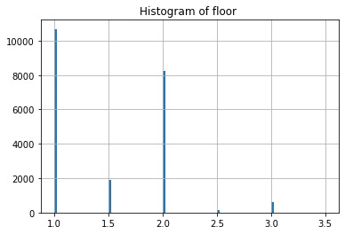
Data Distribution
Notes:
Sqft_living, Price_new, and grade are normal distributed.
Bathrooms & floor : skew to the right

Slide 17
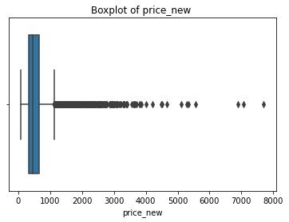
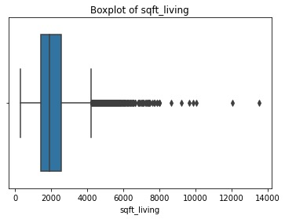
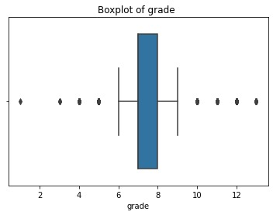
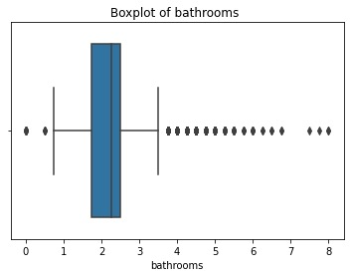
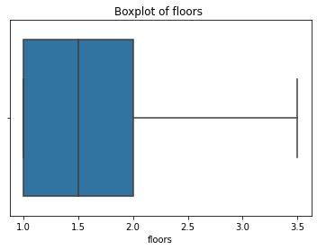
Detect Outlier
Notes:
As you from the boxplots, only floors does not have any outliers. The other variables have lots of outliers in their right side. Which means that lots of data are over the upper bound.
Since the numbers of outliers are super many, it may lead to a big consistency for our analysis if we delete any of them. THerefore, we decided to keep all the outliers.

Slide 18
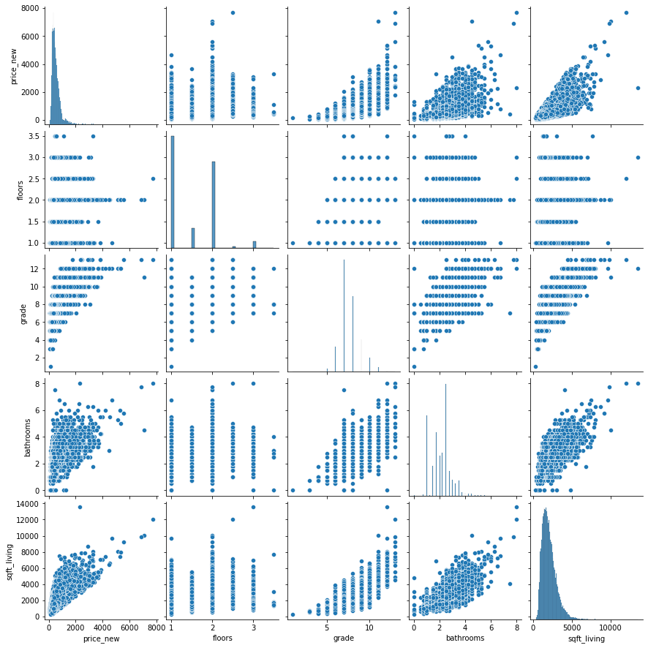
Pairplot
price --- sqft_living : '+'
price --- bathroom: '+'
price --- grade: '+'
price --- floor: NO correlation
Notes:
Based on the pairplot, if you see the first column. The most botom 1, 2, and 3 are having the same upward trend. As the price goes up, the number of sqft-living, numbers of bathrooms and the level of grade also goes up. Therefore, we can conclude that the price has a positive correlation with sqft_living, bathroom and grade.
However, in the second graph of the first column. You can see that the dots were normal distributed. So, we coulnd't find any strong correlation between these two variables. So, we will say, there is no correlation between the numbers of floor and the housing price.

Slide 19
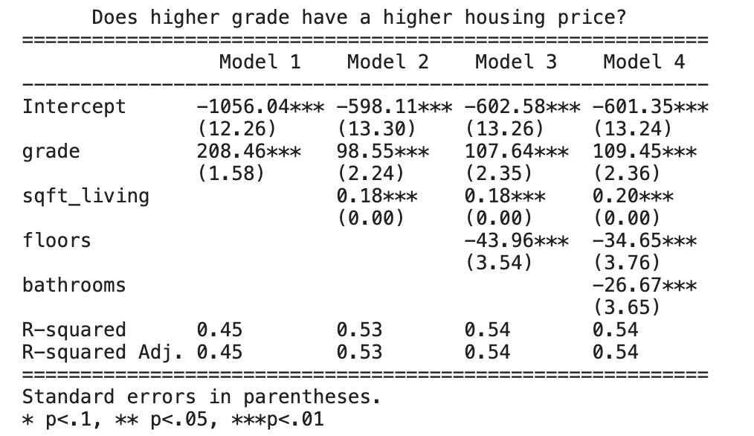
Regression
With the increase in one level of grade, the housing price will increase by $109, 450.
With the increase in 1 ft² of living room, the housing price will increase by $200.
With the increase in one floor, the housing price will drop by $34,650.
With the increase in one bathroom, the housing price will decrease by $26,670.
Notes:
For the regression part, we employ the mutllinear regression model.
We generate the regression model by 4 times. And each time add a new variable inside and see how the coefficient values are changing. So, firstly, we generate grade as model 1. Then added sqft-living, floors and bathrooms in order.
Since we divided the price by 1000 before, here we will need to multiply the coefficient value by 1000 when we do interpretation.
In all models, Grade has the largest coefficient value which also means that it has the greatest impact on housing price.
The positive values also match with the positive correlation in the pairplot analysis. Therefore, we can also answer our research question as: the higher grade does have the greatest impact on the housing price.
If you look at the data horizontally for sqft_living, you can see that the values are very like the same. So, we can say that sqft-living has a very stable impact on the housing price.
As for floors and bathrooms, they both have negative values.
From the pairplot, it shows there is no obvious correlation between floors and price. So, this negative coefficient value is questionable.
To further explain the negative values of these two variables, we need to do more research on consumers preference and behavior in that particular year.

Slide 20
PART 04
Conclusions & Suggestions

Slide 21
Results
Price
vs.
Grade
With the number of schools increase, the housing price increase
Price
vs.
Sqft_Living
As the living room size increased, so did the price of the house
Housing
Price
vs.
Floor
Hypothesis Test Failed. There is no correlation between price and
floor but it is statistical significance.
Price
vs.
Bathrooms
Hypothesis Test Failed. Regression model shows that With the number of bathrooms increase, the housing price decrease.

Slide 22
Conclusion
Among the number of bathroom, floors, and size of living room
"GRADE" have the greatest impact on housing prices.

Slide 23
Suggestion &
Limitation of Data
Missing sufficient data to analyze the impact of floors. We may need the size of each floor to get a better understanding on the impact of this variable.
Living purpose:
Buy the one which is far away from schools
Data did not provide enough variables that could be used for analyzing the impact of neighborhoods
Investing purpose:
Buy the one which is close to schools
Notes:
As for suggestion, we suggest consumer who have limit budget with a living purpose, to buy the house that is far away from schools. It could be cheaper.
If consumers have enough budget. We suggest them to buy the houses with a high level of grades. Because we expect grade has the biggest impact on the housing price. And an increase of it will increase a lot in the housing price. Therefore, investor may earn a lot of money if they bought the houses which are around the school area.
In our dataset, it only provides the numbers of floors but did not provide the size of each floor. If we want to analyze how floors impact the housing price. We need to gather more information.
So next time, we can pick other variables which could be used for analyzing the impact of neighborhood and do a different analysis.

Slide 24
Reference
Engle, Robert F., David M. Lilien, and Mark Watson. "A Dymimic Model of Housing Price Determination." 07 Mar. 2002. Web. 02 Apr. 2021.
Kiel, Katherine A., and Jeffrey E. Zabel. "Location, Location, Location: The 3l Approach to House Price Determination." 10 Jan. 2008. Web. 02 Apr. 2021.
"Median Home Price." 15 July 2020. Web. 02 Apr. 2021.
"Median Sales Price of Houses Sold for the United States." 28 Jan. 2021. Web. 02 Apr. 2021.
Oloke, O. C., Y. A. Olawale, and A.S Oni. "Price Determination for Residential Properties in Lagos State, Nigeria: The Principal-Agent Dilemma." 01 Jan. 1970. Web. 02 Apr. 2021.
"Trends in Home Buyer Preferences." Web. 02 Apr. 2021.
"Washington and U.S. per Capita Personal Income." 14 July 2020. Web. 02 Apr. 2021.

Slide 25
THANKS FOR WATCHING

